Slide 1
Andreas Lorenz
AWS Engagement Ready Program
Final Project
15.07.2025

Slide 2
Application Overview
The B2B Shop is a basic single-page application built with Angular, TypeScript, Java, SpringBoot, PostgreSQL, Redis, EKS and Terraform to demonstrate core e-commerce functionality for B2B scenarios. It includes a product list view, a shopping cart, and simple state management using a caching service. The application focuses on modular design, fault tolerance, and scalability, providing a foundation for further extension with authentication and advanced ordering workflows. Disclaimer: The app was developed as a prototype without external dependencies or real data sources and therefore does not feature all functionalities a production ready application should offer.

Slide 3
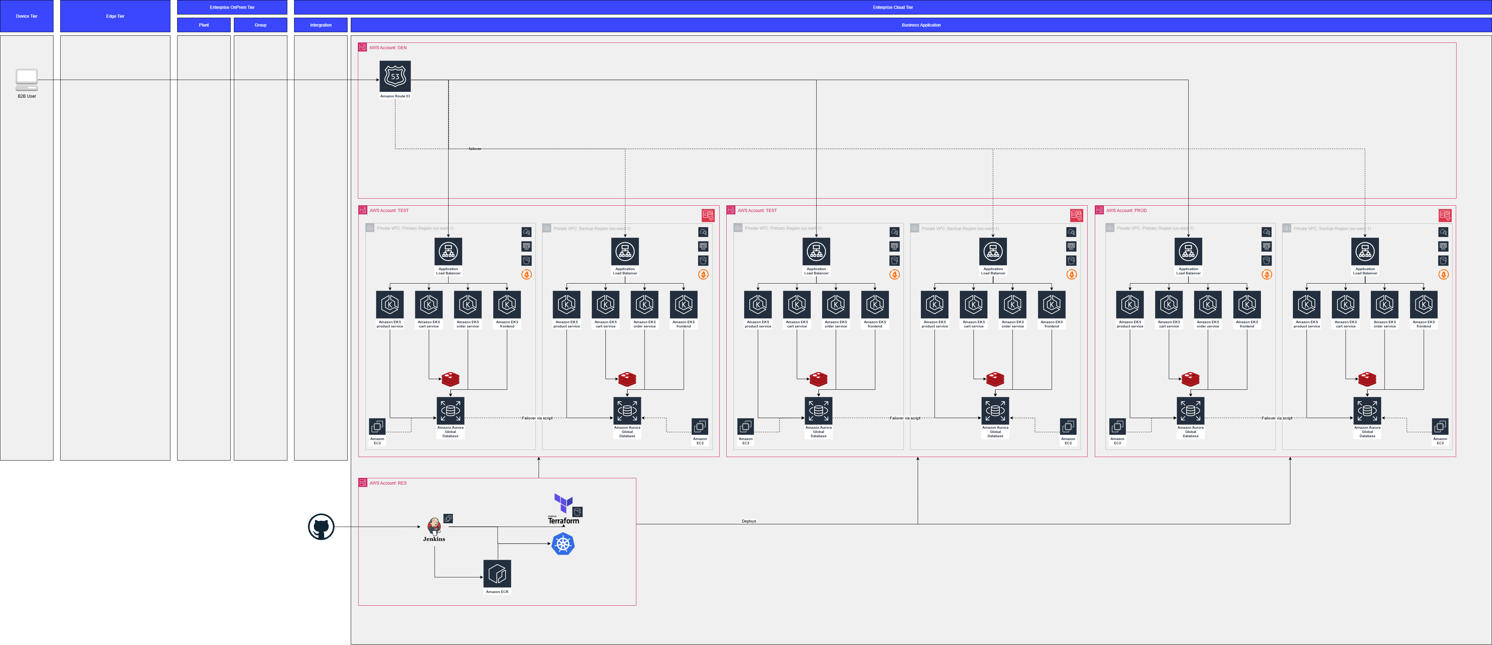
Architecture

Slide 4
12 Factor App
Factor | Architecture Solution
Codebase | All code is stored in separate GitHub Repositories with branch management options
Dependencies | Only Technologies used that offer dependency solution: Maven for SpringBoot and npm for Angular
Config | All configuration is part of script and configuration files in GitHub Repos
Backing services | Caching (Redis) and Database (Postgres Aurora) are
Build, release, run | Individual Pipelines are setup in Jenkins to facilitate build, release, run
Processes | All containers are stateless and data is only stored in caching and database solutions
Port binding | EKS is utlized to bind specific ports via Kubernetes Services
Concurrency | As all contaners are stateless, they can be individually scaled up and down, while all working concurrently
Disposability | All parts of the computational and visual architecture are stateless microservices and are therefore disposable
Environment parity | Jenkins is setup in a way that gurantees parity for four environments (test, dev, int, prod)
Logs | Logs are centralized via Grafana (Loki), Prometheus and CloudWatch
Admin Processes | All admin tasks are bundles as bash scripts inside a github repo

Slide 5
Hands on Look
Jenkins
Frontend
EKS Cluster
ECR
GitHub
Grafana

Slide 6
Choosing Compute Service
Task | ECS | EKS | Lambda
Estimate the effort required to develop the application for the target platform (H, M, L). | M | M | M
Estimate the effort required for the team to learn the new platform (H, M, L). | L | L | L
Estimate the effort required to maintain and administer the target platform over time (H, M, L). | M | L | H
Which would you recommend? |  | Great usecase, as the app needs easy scalability and HA

Slide 7
Disaster Planning
Resource | Backup Plan | Backup Location | Restore Procedure
Primary Database | Full daily backup + transaction log backups every 15 min | On-prem backup storage + offsite secure vault | Restore full backup, then apply transaction logs up to failure point
Application Server Config | Config files backed up weekly and before changes | Central config management system | Re-deploy config files from backup and validate against latest version
Infrastructure VM Images (Jenkins and Bastion) | Weekly snapshots | Offsite disaster recovery site | Restore VM snapshots and reconfigure network settings

Slide 8
Security Measures
Data Encryption
In Transit: TLS 1.2+ for all communication (users, app servers, DB)
At Rest:
Aurora encrypted with AWS KMS customer-managed keys (CMKs)
Backups encrypted with AWS-managed keys
Key Management:
Customer-managed keys in AWS KMS for control and auditability
Option for BYOK if compliance demands
Access Control
User Access: Role-Based Access Control (RBAC) with AWS Cognito
Data Access:
External users limited to transactional data via secure APIs
Internal/admin data receive privileged users with MFA
Authentication: AWS Cognito
Auditing: Continuous monitoring via AWS CloudTrail and logging
Network Security
External Traffic:
Only HTTPS (port 443) and essential service ports allowed via Security Groups
AWS WAF protects frontend from common web threats
Internal Traffic:
Micro-segmentation in VPC separating app and DB tiers
Security Groups permit only necessary tier-to-tier communication
Firewall Rules & ACLs:
Managed as code (Terraform, Kubectl) with automated reviews
Regular audits ensure compliance and operational security

